Slide 1
40th UN/CEFACT Forum
8-12 May 2023
Feedback about Travel & Tourism Domain
Anthony Chien
Chair, Tourism, Travel & Leisure Working Group, AFACT
Deputy Director of CIDS, Commerce Development Research Institute, TAIWAN
anthonychien@cdri.org.tw
11 JUL. 2023
AFACT Mid-Term meeting

Slide 2
https://unece.org/info/events/event/377602

Slide 4
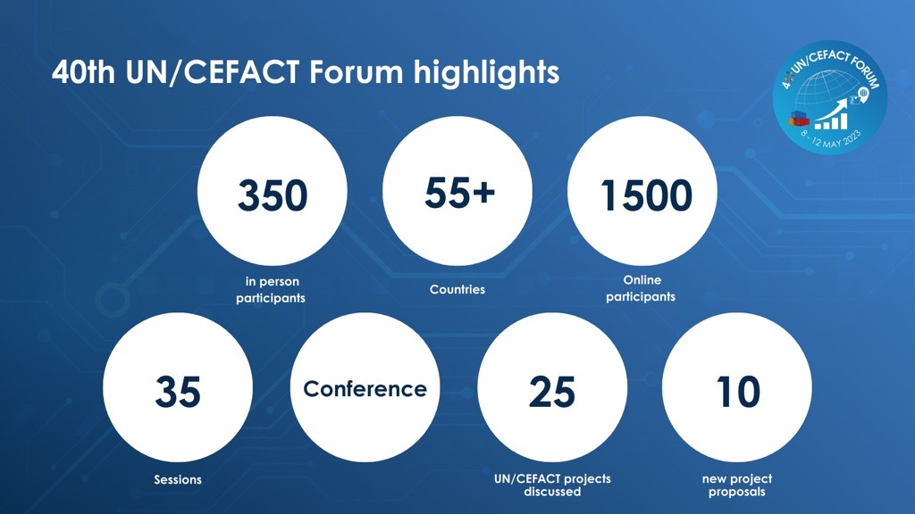

Slide 5
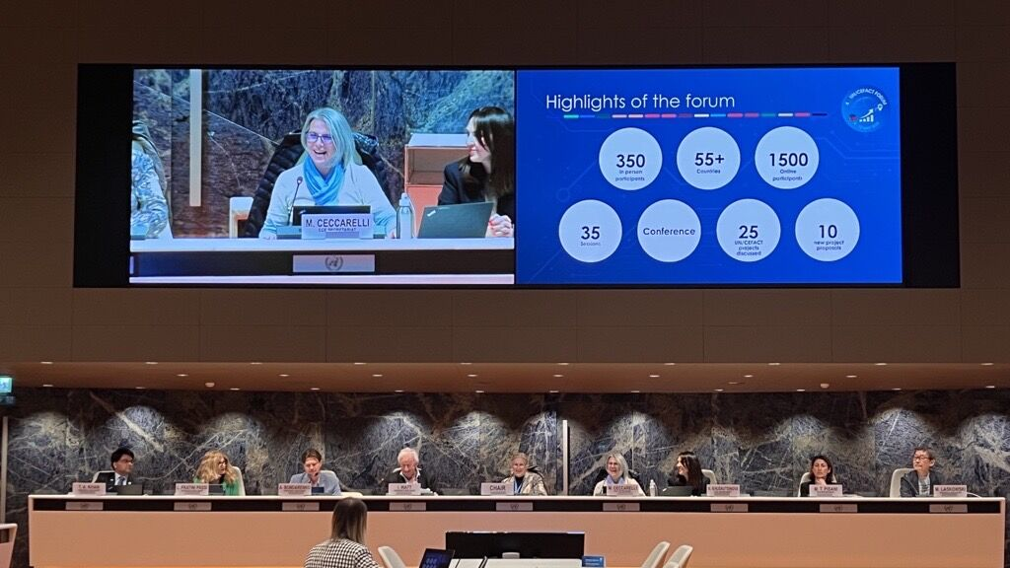

Slide 6
40th UN/CEFACT
Forum
8-12 May 2023
Travel Agency and DMC&DMO Package Tour Project
Tunghua Tai / Founder, Siloah Travel / tunghua.tai@gmail.com
Anthony Chien / Deputy Director of CIDS, Commerce Development Research Institute /
anthonychien@cdri.org.tw

Slide 7
Travel Agency and DMC & DMO Package Tour Project
Project purpose
Project scope
Proposed project leadership

Slide 8
Project purpose(1/4)
“Package Tour” has been the most popular way of travel in the past century.
Hundreds of thousands travel agencies and Destination Managing Company (DMC) and Destination Managing Organization (DMO) are servicing travelers in this industry, since Internet was invented.
Big OTAs (Online Travel Agency) are prominent in the industry, using IATA airline standards, and OTA (Open Travel Alliance) hotel booking standards, traditional travel agencies and DMCs/DMOs are being left behind at this Internet travel trend.
They don’t have a sector relevant standard for exchanging data between each other.

Slide 9
Project purpose(2/4)
In this OTA era, people tend to travel FIT (Free Individual Traveler), but the fact is distinctions suitable for FIT is limited by security condition, transportation convenience condition and language barrier etc, the result for FIT is finally most travelers stay in big city.
OTAs are only “matching platform” for traveler and travel resources.
The opportunity and requirement are for Travel Agency coordinating with DMCs can provide service and knowledge added value to design better itinerary and bring travel to wider choice of destinations.

Slide 10
Project purpose(3/4)
Before actual travel occur, the product in travel industry is only “information”, no physical products exist, and most of travel agencies and DMCs are small and medium business entity where currently no open standards exit.
Currently the big OTAs are all making their own API rules them self, without a global API standard, OTAs connecting each other by using all different API standards are very big and expensive task already.
Without recognized open standards SME MSME travel agencies are inhibited from contributing to the industry.

Slide 11
Project purpose(4/4)
The small Travel Agencies to develop software to connect to different OTAs by different API standards is nearly mission impossible, open global standards as produced by UNECE-UN/CEFACT and the purpose of this project will overcome this challenge.
The challenge facing the SME travel Agency is the same os faced by SME’s in global trade of goods.
UNECE-UN/CEFACT mission is to produce standards bridging the gap between large corporate bespoke platforms and SME engagement in the industry.
The purpose of this project is to design a set of API standard for exchanging “Itinerary”, “Quotation”, “Package Tour”, “Traveler”, and “Review” data between for travel agencies (including traditional travel agencies and OTAs), between travel agencies and DMCs, and between DMC to DMCs.

Slide 12
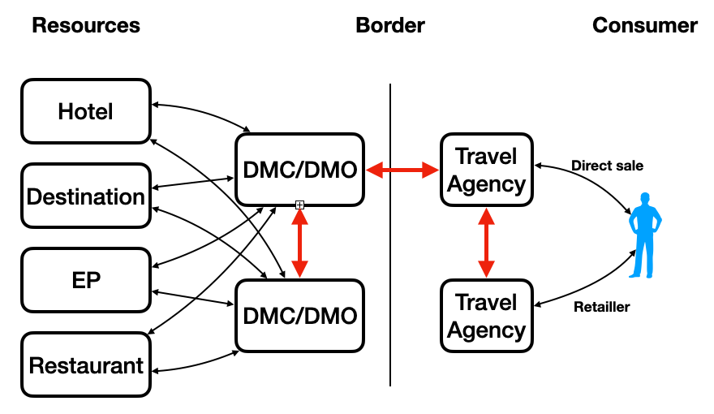
Project scope (1/2)
The project enables replacing the current emails and spreadsheets used to exchange tour package data between Travel Agencies (mostly SME’s) and Destination Managing Company (DMC) and Destination Managing Organization (DMO) with harmonized data and comments.
(Ref red arrows in the diagram below). This will deliver additional semantic data definition into the CCL, RDM establishing the ability to write standardized APIs.

Slide 13
Project scope (2/2)
The project is to produce definitions and Reference Data Models (RDM) on Travel Agency, Destination Managing Company (DMC) and Destination Managing Organization (DMO) API. It does not deliver a certification system but it provides elements upon which certification or labeling systems could be build.
The project will also deliver components of future recommendations to government to facilitate, promote Travel Agency, Destination Managing Company (DMC) and Destination Managing Organization (DMO).
The project will take in consideration work which has been produced by UN/CEFACT on White Paper on the technical applications of Business Standards for Sustainable Tourism being a subset of sustainable tourism products.
ITEMS:
1. Itinerary, 2. Quotation, 3. Tour, 4. Traveler, 5. Review
PHASES:
1. Design, 2. Marketing, 3. Booking, 4. Traveling, 5. After Travel

Slide 14
Proposed project leadership
Project leadership might be constructed by one Project Lead, two Sub-Leads, and one Editor as in the following.
Lead: Mr. Tunghua Tai e-mail address: tunghua.tai@gmail.com
Sub-Lead: Mr. Sachin Mehta e-mail address: sachinashokmehta@gmail.com
Sub-Lead: Mr. Tadashi Ishihara e-mail address: ishihara1943@ab.auone-net.jp
Editor: Dr. Anthony Chien e-mail address: penguinchien@gmail.com
Editor: Mr. Daniele Tumietto e-mail address: tumietto@economisti.it
Editor: Mr. Matt Jiang e-mail address: matt.jiang@gmail.com
Vice Chair: Ian Watt email address: ian.watt@nextradeworld.com

Slide 15
Travel Agency Data Exchange
Big picture for Travel Industry
Existing API Standards
Package Tour vs FIT
How Package Tour Works Without API
5 Travel Phases and Data Exchange
Open Data for Travel Industry
Challenges for Travel API

Slide 16
Travel Industry
 |  | Existing API Standard
Food | Restaurant
Accommodation | Hotels, B&B, Lodging House | Open Travel Alliance (XML), SLH
Transportation | Airline, Train, Cruise | NDC by IATA (XML)
Destination | Museum, National Park
Shopping | Gift Shops
Entertainment | Theater, Opera, Theme Park
Travel Agency | Agency, DMC, DMO, Guide
Local Government | Tourism Bureau
Experience Programs | Culture Experience, Activities, Excursion | EP project
Traveler

Slide 17
Challenges
Data Protection
Government
DMC/DMO
Agency
Traveller
Visa Required Data Structure:
Name
Phone
Birthday
Passport Number
APP
Public Key
Private Key
Public Key

Slide 18
Thank you for your attention!
40th UN/CEFACT Forum
8-12 May 2023
Tunghua Tai / Founder, Siloah Travel / tunghua.tai@gmail.com
Anthony Chien / Deputy Director of CIDS, Commerce Development Research Institute /
anthonychien@cdri.org.tw

