Slide 1
Agriculture ESG Digital Platform

Slide 2
「Link Join Agriculture」
Agricultural Information Software Service Provider
Founded in: 2021.12 Capital: 50 million Co-workers: 40 employees
Service for: Agricultural Information software (ERP, Inventory management, Processing and Production, Financial Accounting)；Smart Agriculture Applications (Smart Production, Smart Aquaculture)
2

Slide 3
Agricultural Sustainable Digital Ecosystem
Safety
Sustainability
High Quality
．Agricultural Product Environmental Report
．Establishment of Agricultural Product Sustainability Index
．Promoting Sustainable Consumption of Agricultural Products
．Source ．Traceability
．Pesticide ．Material
． Verification ．ERP
．Production Lead Time Prediction
．Compliant Production Data
．Production Volume Forecasting
Production Data Trust Mechanism
Agricultural Product Yield and Price Forecasting Mechanism
Establishment of Sustainable Digital Ecosystem for Agricultural Products
Link with the enterprise
Farmers' Guidance and Support
Building international Sustainable Agriculture Alliance

Slide 4
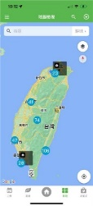
Agricultural Sustainable Digital Ecosystem & Standard
Traceable Agriculture Product
Product Traceability Data
Business model
Field Production Management
Sustainable Agri-food Management Platform
Farmland Data
Sustainable
Agriculture
Data
Smart Marketing System
Sustainable Agriculture Guideline
Cultivation
Sustainability
Guidelines
Sustainable Agriculture E-commerce Platform
Kaohsiung Agrinfo
Agricultural Industry Information Platform
Farming Operation
Cultivation Environment Inspection Management
Customer
Orders
Sustainable Agriculture Data Application and Management System
Pest and Disease Control
Farm
Data
Integration of Traceable Agriculture Product
Government Open Data Platform
( Weather, Disaster, Geospatial, Market Data… )
Fertilization
Sustainable Order Shipping Management
Materials Inventory
Enhancing Traceability & Sustainability

Slide 5
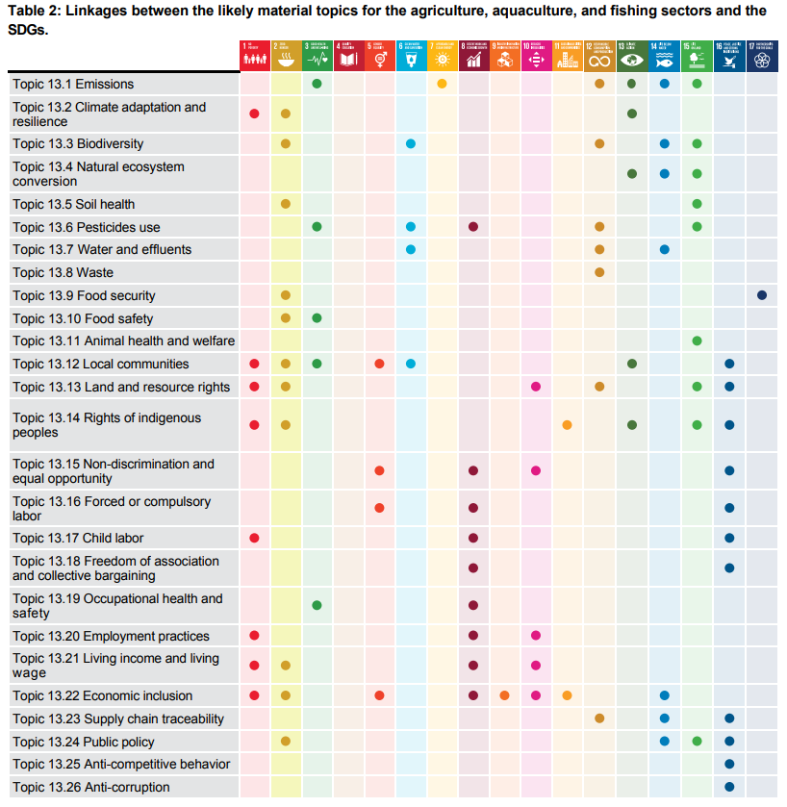
Smart Agriculture GRI Standard
Global Reporting Initiative has published GRI 13 (Agriculture, Aquaculture and Fishing Sectors 2022) that is the first standard for all companies in the upstream production of crops, animals and seafood, setting expectations for disclosure of their shared and distinct impacts.
GRI13 disclosures on food security, land and resource rights, living wage and income, natural ecosystem conversion, animal welfare, soil health, and pesticide use

Slide 6
Asia Pacific Agricultural Sustainable Digital Standard
Collaborate with AFACT members:
Referring to GRI 13 standard and UN/CEFACT project (Traceability for Sustainable Value Chains ) to construct Agricultural Sustainable Digital Ecosystem & Standard.
Facilitating agricultural trade in Asia and the Pacific .
Promoting agricultural trade data exchange.

