Slide 1
AFACT TT&L WG Activities
Anthony Chien
Chair, Tourism, Travel & Leisure Working Group, AFACT
Deputy Director of CIDS, Commerce Development Research Institute, TAIWAN
anthonychien@cdri.org.tw
11 JUL. 2023
AFACT Mid-Term meeting

Slide 2
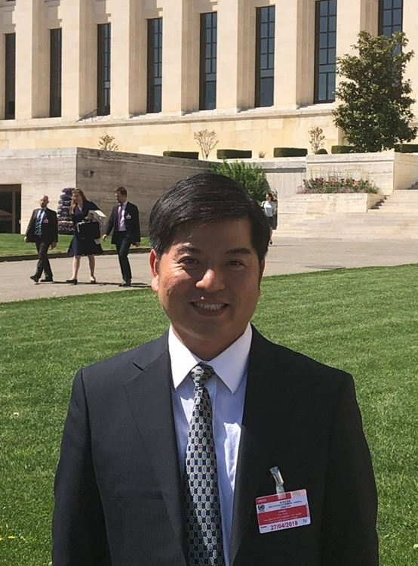
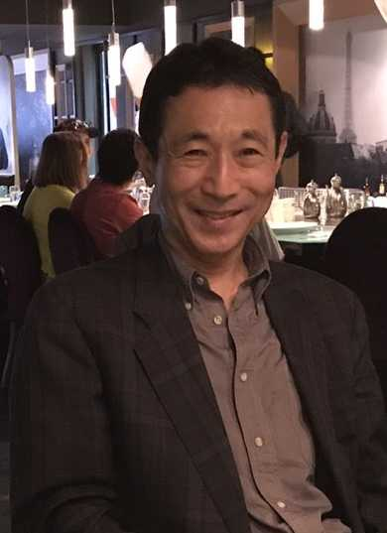
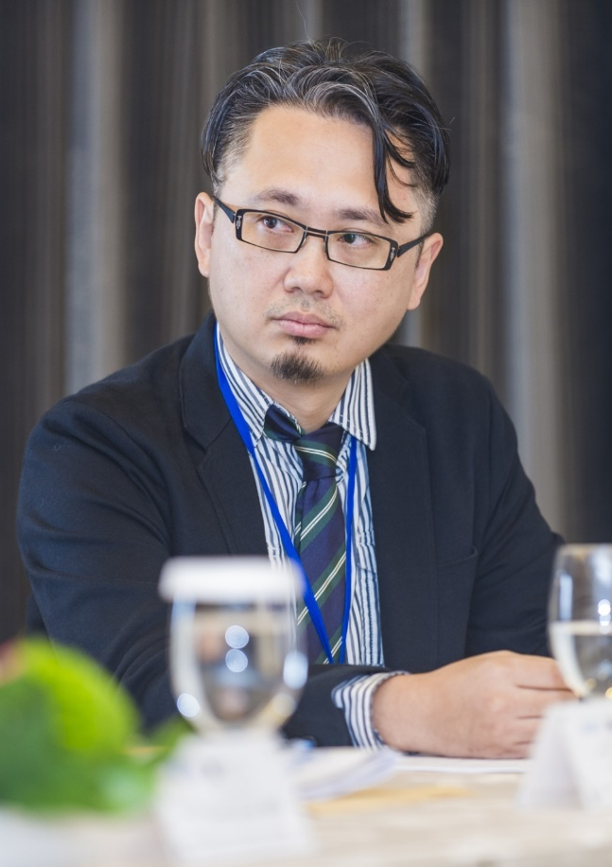
Management Team of TT&L WG
The AFACT Steering Committee Meeting nominated Dr. Anthony Chien as TT&L WG Chair for the period of 2021-2023 on 2020-12-09.
The AFACT Steering Committee Meeting nominated Dr. Mikio Tanaka as TT&L WG Vice Chair for the period of 2021-2023 on 2020-12-09.
The AFACT Steering Committee Meeting nominated Mr. Tunghua Tai as TT&L WG Secretary for the period of 2021-2023 on 2020-12-09.
Dr. Anthony Chien as TT&L WG Chair for the period of 2021-2023.
Economy: Chinese Taipei
Dr. Mikio Tanaka as TT&L WG Vice Chair for the period of 2021-2023.
Economy: Japan
Mr. Tunghua Tai as TT&L WG Secretary for the period of 2021-2023.
Economy: Chinese Taipei

Slide 3





AFACT TT&L WG Participants
TT&L WG monthly online meeting from Jan. to Dec. 2022
TT&L WG Participants
Name (Abbr.) | Economy/Org. | ST & EPs Project
Sachin Mehta (SM) | India | Coordinator, UN/CEFACT Travel and Tourism and EPs Project Lead
Anthony Chien (AC) | Chinese Taipei | Chair, TT&L WG, AFACT and ST Project Editor
Tunghua Tai (TT) | Chinese Taipei | ST Project Leader
Matt Jiang (MJ) | Chinese Taipei | ST Project Editor
Wanchun Hsiung (WH) | Chinese Taipei | ST Project Sub-Lead
Gary Lin (GL) | Chinese Taipei
Mikio Tanaka (MT) | Japan | Vice Chair, TT&L WG, AFACT
Akio Suzuki (AS) | Japan | EPs Project Sub-Lead
Tadashi Ishihara(TI) | Japan
Kiyoshi Hara (KH) | Japan
Shoji Nakagome (SN) | Japan | ST Project Sub-Lead
Kazuyoshi Itagaki (KI) | Japan | ST Project Editor
Gil-jun Ko (GK) | Korea
Md. Abul Kalam Azad (Milan) (AA) | Bangladesh
Jahidul Hasan (JH) | Bangladesh
Meetham Naranong (MN) | Thailand
Ian Watt | Australia | Vice Chair, UN/CEFACT
Gerhard Heemskerk | Netherland
Daniele Tumietto (DT) | Italy

Slide 4
Travel & Tourism Domain
PROJECT: Business Standards for Sustainable Tourism
Supporting VC’s: (T&T) @Ian Watt
Domain Coordinator: (T&T) @Sachin Mehta
Project Lead: @Tunghua TAI
Project Purpose:
Several of the UN SDG’s have their application in the tourism industry. Tourism, both globally and regionally can have severe negative impacts on local communities, natural resources, climate and economies. The same applies to accommodation services (Lodgings) etc. The aim of the project is to clearly define sustainable tourism, as well as to set parameters for what can and what should not be considered sustainable tourism
Project status: (Launch: 2019-04-01; Completion 2023-05-31; Publication (Plenary) 2023-06-15
Next Steps:
The project deliverables are: 1: White Paper containing definitions, standards, guidelines for sustainable tourism

Slide 5
Travel & Tourism Domain
PROJECT: API Transformation of EPs Technical Artefacts with Sustainability Claims
Supporting VC’s: (T&T) @Ian Watt
Domain Coordinator: (T&T) @Sachin Mehta
Project Lead: @Sachin Mehta
Project Purpose:
Experience Programs Technical Artefacts Project (P1082) was completed in October in 2022, and some members in the tourism industry expect to have the artefacts transformed into API formats based on the newly constructed technical specifications of UNCEFACT to trade Experience Programs (EPs) much lighter and easier for the use of smart phones. Therefore, this project is proposed to make API applicable to the use of the trade of EPs, which will support the facilitation of their trade.
Project status: (Launch: 2023-05-08; Completion 2024-04-30; Publication (Plenary) 2024-05-31
Next Steps:
1: Begin by working based on UN/CEFACT developing procedures.
2: Reviewing existing BRS
3: Work step by step to Complete the API Transformation.

Slide 6
Travel & Tourism Domain
PROJECT: Travel Agency and DMC&DMO Package Tour Project
Supporting VC’s: (T&T) @Ian Watt
Domain Coordinator: (T&T) @Sachin Mehta
Project Lead: @Tunghua TAI
Project Purpose:
The project enables replacing the current emails and spreadsheets used to exchange tour package data between Travel Agencies (mostly SME’s) and Destination Managing Company (DMC) and Destination Managing Organization (DMO) with harmonized data and comments. (Ref red arrows in the diagram below). This will deliver additional semantic data definition into the CCL, RDM establishing the ability to write standardized APIs.
Project status: (Launch: 2023-05-08; Completion 2024-09-30; Publication (Plenary) 2024-11-30
Next Steps:
1: Analyze business logic for travel agency and DMC/DMO.
  2: Collect document and start to work on "Use Case Diagram" and "Class Diagram"
  for API Project.
    3: Decentralize ID talk to eData WG and link to relevant project

Slide 7
Thank you
Anthony Chien
Chair, Tourism, Travel & Leisure Working Group, AFACT
Deputy Director of CIDS, Commerce Development Research Institute, TAIWAN
E-mail: anthonychien@cdri.org.tw

